Slide 1
Medium Access Control Sublayer
Notes:
Video Module 4.B-01

Slide 2

Overview
Objectives
Learn and understand Medium Access Control (MAC).
Overview Multiple Access protocols
Learn and understand the IEEE 802 protocol suite.
Requirements
Know the OSI reference model
Read introduction to Chapter 4
Skim 4.1.1
Read Section 4.2 up to Section 4.2.3
Read Introduction of Section 4.3
Read Sections 4.3.1 and 4.3.2

Slide 3
Medium Access Control (MAC)
Function, role, and position in the OSI Reference Model
Why, when do we need MAC?
A fundamental result from queueing theory
Type of multiple access protocols
Contention based
Collison-free
Read Introduction of Chapter 4
Skim 4.1.1

Slide 4
Where in the OSI Reference Model ?
Application
Presentation
Session
Transport
Network
Logical Link Layer
Data Link Layer
Medium Access Control
Physical

Slide 5
Why Do We Need a MAC Layer ?
Let us consider different topologies
Point-to-point channel
full duplex: channel allows simultaneous communication in both directions
Do I need medium access control?
Answer: No, each user has a dedicated channel not shared with the other. It like a two way street. Cars can use the street in both ways at the same time.
half duplex: : channel allows alternate communication in both directions. Cannot handle simultaneous transmissions in opposite directions
Do I need medium access control?
Answer: Yes. Half duplex is like a bridge that can accommodate only cars going in the same direction. Cars going in opposite directions must take turns.
Broadcast channel
When one stations transmits, every station on the channel hears and understand
When two or more transmit, every station on the channel hears, but does not understand ANYTHING.
Do I need medium access control?
Answer: Yes. It is like people in the same room.
Notes:
Is a landline phone half or full duplex? Maybe broadcast?
Broadcast, random access, multi-access
Where do we use typically each one?

Slide 6
Management of Broadcast Channels
Allocating statically shares of the channel to all stations (by TDM, FDM, or other)
Let stations compete for the full channel
Servers
One server

Slide 7
A Fundamental Result In Queueing Theory
One powerful server for all is better than one weak server for each one !
Why ? Better utilization, as a (statically assigned) dedicated channel may stay IDLE.
One server

Slide 8
Multiple Access Protocols
Competing stations (Contention based: possible collisions)
Good average delivery time
No guaranteed delivery time (no bound)
Collision-free
Higher average delivery time ( higher than contention based protocols’)
Guaranteed delivery time (bounded waiting time)

Slide 9
Multiple Access Protocols
Competing stations (Contention based: possible collisions)
Aloha
Slotted Aloha
CSMA
CSMA/CD
Collision-free
Token passing
Read Section 4.2 up to Section 4.2.3 (included)
Skim 4.1.1
Notes:
Video Module 4.B-02

Slide 10
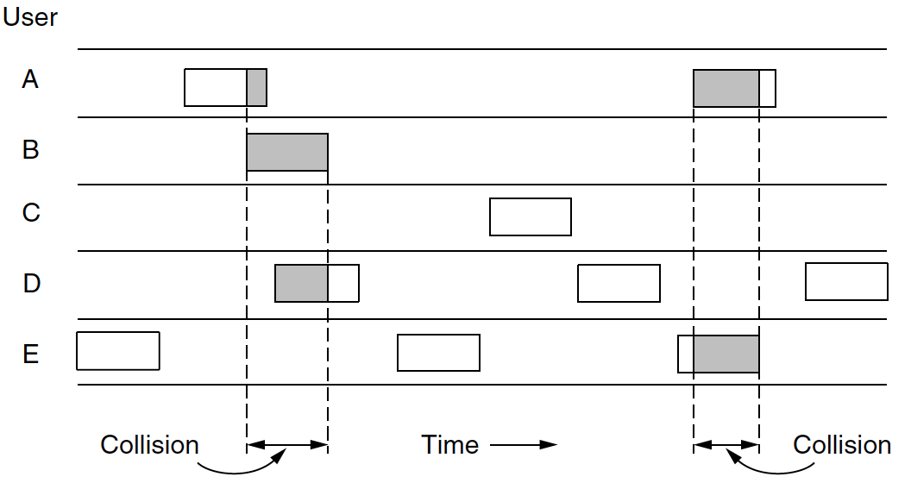
Contention: Pure Aloha
Designed by Abramson (wireless)
Protocoll Rule: A station emits whenever it has something to send
If other stations emit while any station is transmitting, a collision occurs
If a collision occurs, then the frame must be resent
Best possible efficiency at high load 18%

Slide 11
Contention: Slotted Aloha
Designed by Roberts (wireless)
Requires synchronization and division of time in discrete slots
Slot time = time to send one frame
A station emits whenever it has something to send AND must wait for beginning of slot
Best possible efficiency at high load 37%
Slots
A
B
C
D

Slide 12
Contention: Carrier Sense Multiple Access (CSMA)
Designed by Metcalfe, analyzed by Kleinrock and Tobaggi
A station listens to the channel before sending.
If channel busy, wait until it becomes idle
When channel free, send…
Are collisions still possible?
Yes!
After a collision, how long to wait before sending?
Immediately after the channel is idle?
Wait two minutes after the channel is idle?
How to adapt to the traffic conditions?
Notes:
Discuss binary exponential back off.

Slide 13
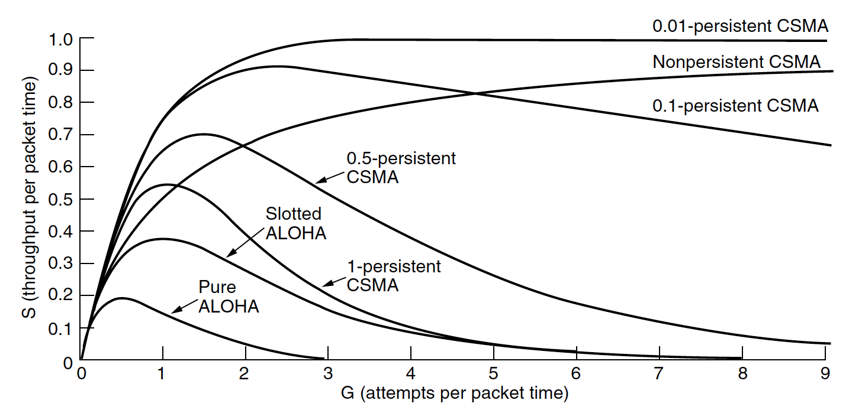
Contention: CSMA/CD (Collision Detection)
KEY: stop transmission of damaged frames (collision)
Requirement: sender must keep listening when sending.
Relationship with medium length

Slide 14
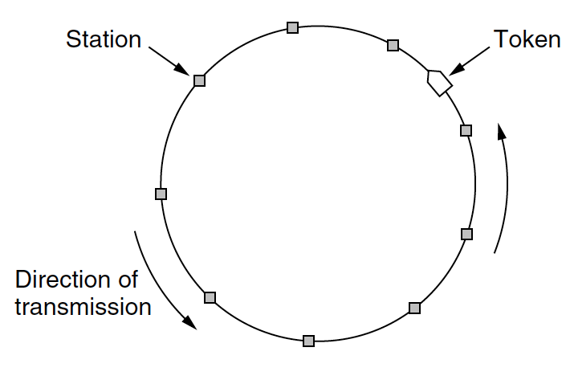
Collision Free: Token Passing
A special frame (Token) circulates between station in a round robin manner
A station can emits ONLY if it has the token
A station can keep the token only for a limited time.
When the time to keep the token expires, the station must send the token to its “successor”.

Slide 15
IEEE 802 Standards
What is the IEEE 802 Suite?
A set a protocols for MAC:
IEEE 802.1 : general introduction
IEEE 802.2 : Logical Link control
IEEE 802.3 “Ethernet”
IEEE 802.4 Token Bus
IEEE 802.5 Token ring
IEEE 802.11 Wireless
Read Introduction of Section 4.3
Read Sections 4.3.1- 4.3.2
Notes:
Video Module 4.B-03

Slide 16
Common Parts To Different MAC Schemes
IEEE 802.1 : general introduction
IEEE 802.2 : Logical Link control

Slide 17
IEEE 802.3
DIX Ethernet standardized.
Based on 1-persistent CSMA/CD
Good utilization and average delay
NO GUARANTEE on time delivery
Good for bursty and irregular traffic with no time constraint

Slide 18
Ethernet (RFC 894)
Preamble
Dest
Source
Type
Payload
CRC
6
6
2
46-1500
Examples of payloads
IP Packet
ARP Request/Resp.
IPv6.
0x0800
IP Packet
0x0806
ARP
PAD
2
28
18
0x86DD
IPv6
PAD
2
28
18

Slide 19
DIX and 802.3 Frames
DIX
Preamble
Dest.
Source.
Type
Payload
CRC
8
6
6
2
Up to 1500
4
IEEE 802.3
Preamble
Dest.
Source.
Length
Payload
CRC
8
6
6
2
Up to 1500
4
How to make the difference?

Slide 20
IEEE 802.4 Token Bus
Logical ring on a bus
A station does not emit until it gets a unique circulating token
Not widespread

Slide 21
IEEE 802.5 Token Ring
Ring topology
Station does not emit until it gets the circulating token
Guaranteed delivery delay
Good for stations “equally” loaded

Slide 22
IEEE 802.11 Wi-Fi
Wireless Access (most likely used by your access point at home)
IEEE 802.11 a/b/g

Slide 23
Wrap Up
Learn and understand Medium Access Control (MAC).
Overview Multiple Access protocols
Learn and understand the IEEE 802 protocol suite.

